Slide 1
Binomial valuation
Option pricing

Slide 2
Quiz: Traditional Binomial
You flip a coin. If heads you get $2, if tails you get 0. What is the fair value of this game?
2
0.5
0.5
0

Slide 3

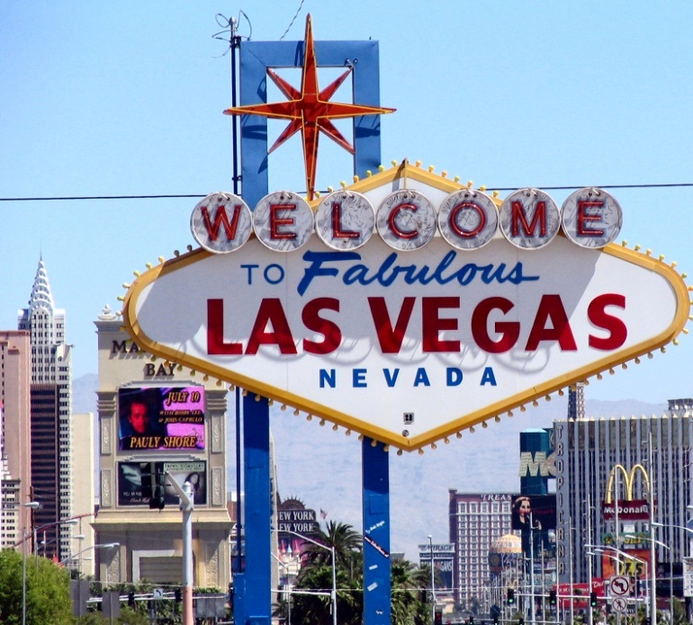
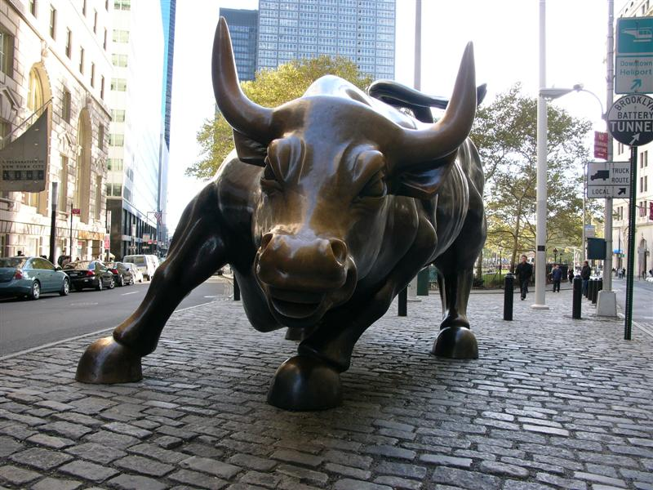
...............Wall Street!

Slide 4
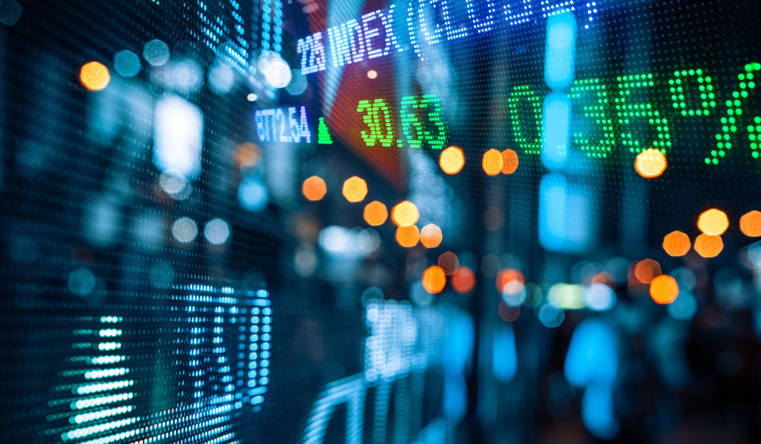
Wall Street Games
Assume a stock is trading at $96. Tomorrow the price will either be $102 or $92, each with a chance of 50%. The risk free rate is 0%. A 1-year call option has a strike of $100. What is the price of the call option under these restrictive assumptions?
Draw call payoff first.
Take Quiz (Financial Binomial).

Slide 5
Call Payoff
Assume a stock is trading at $96. 1-year later the price will either be $102 or $92, each with a chance of 50%. The risk-free rate is 0%. A 1-year call option has a strike of $100. What is the payoff diagram of the call option?
.5
2
?
.5
0
Call

Slide 6
Suppose C = $1(remember stock = 96, r = 0%)
Sell 10 Calls (to someone) (Get $10)
Borrow $182 (Now you have $192) at r = 0%
Buy 2 Stocks (Pay 96 x 2 = 192)
Stay on it…
What happens at year end?

Slide 7
Fill in the payoffs 1-year later Quiz Delta hedge
1-year later Stock | Sold 10 calls (strike 100) | Bought 2 stocks | RETURN Borrowed 182 | Total Gain/Loss
102 | a | c | e | g
92 | b | d | f | h

Slide 8
What is the binomial tree asking?
Investigate the binomial pricing approach.
Is the market price equal to fair value (discounted expectation)?
Experiment with coin flipping game again….
Quiz: Risk Aversion

Slide 9
Risk aversion, St. Petersburg paradox, John Von Neumann
Risk aversion and utility functions U
Personality is risk averse if utility function is concave
Personality is risk neutral if utility function is linear
Personality is risk loving if utility function is convex
Is your utility function concave?

Slide 10
What is the market? Risk averse?
The market risk aversion is a weighted average of the risk aversion of all its participants.
Hence market must be risk averse with a concave utility function.
This utility function is not computable.
Without knowing the utility function, you cannot solve binomial pricing problems! These are ill posed problems. You do not have the information to solve the problem.
…unless…

Slide 11
Replication
The delta hedge shows what instruments replicates the call!
Now you can bypass the utility function!

Slide 12
Probability and risk aversion are not needed for computing the price!!!!
Note: nowhere in the replication do we need the probabilities!
This is a probability free construction.
Hence both the probability distribution and the risk aversion measure are not required!!

Slide 13
Return of probability
But we like probability.
Assume the simplest utility function
Imply probability and operate normally…!
This is the risk neutral valuation.
Why is it called risk neutral?

Slide 14
Von Neumann Chart
Personality | Discounted Exp Vs. Market Price | Utility | Stochastic Process | Sharpe ratio
Risk Averse
Risk Neutral
Risk Loving

Slide 15
Von Neumann Chart
Personality | Discounted Exp (DE) Vs. Market Price (MP) | Utility | Stochastic Process | Sharpe ratio
Risk Averse | MP < DE | Concave | Super-martingale | positive
Risk Neutral | MP = DE | linear | martingale | 0
Risk Loving | MP > DE | convex | sub-martingale | negative

Slide 16
Risk Neutral Valuation

Slide 17
1. 1-step tree with vol
Stock is at 100. The volatility is at 40%. Risk free rate is at 5%. Price an at the money 1 year European call option using a 1 step tree. Use CRR procedure to get the tree.
Now price an at-the-money European put option.

Slide 18
2. Use a 2 step tree
Stock is at 100. The volatility is at 40%. Risk free rate is at 5%. Price an at the money 1 year European call option using a 2 step tree. Use the CRR procedure.
HW: Now price an at-the-money European put option.

Slide 19
3. Limits
Take more and more tree steps
Do the prices converge or diverge?
If they converge the converge to what?

Slide 20
4. American Option Pricing
Same problem with American call option
Same problem with American put option

